Slide 1
PYTHON PROGRAMMING Unit V
By,
Dr. S. Sathyapriya
Assistant Professor,
Department of Computer Science
St. Joseph’s college, Trichy

Slide 2
Unit– V: (12 hours)
Exception Handling: Built-in Exceptions-Handling Exceptions-Exception with Arguments - Raising Exception - User-defined Exception - Assertions in Python. Regular Expressions: The match() function - The search() function - Search and Replace - Regular Expression Modifiers: Option Flags-Regular Expression Patterns-Character Classes-Special Character Classes - Repetition Cases - findall() method - compile() method.

Slide 3
Exception Handling
An Exception is an abnormal condition that is caused by runtime error in the program
E-g: Division by zero
When a Python script faces a situation it cannot handle, raises an exception
An exception is a Python object that represents an error
If the exception object is not caught and handled, will display an error
Exception handling is catch an exception object thrown by an error condition and display error message for taking an action and continue executing the remaining part of the program

Slide 4
Built-in Exceptions
Exception Name | When it is raised
AttributeError | Raised in case of failure of attribute reference or assignment
EOFError() | Raised when there is no input from either the raw_input() or input() function and the end of the file is reached
Exception | Base class for all Exceptions
ImportError | Raised when an import statement fails
KeyError | Raised when a specific key is not found in the dictionary
ZeroDivisionError | Raised when a division or modulo by zero takes place

Slide 5
SyntaxError: This exception is raised when the interpreter encounters a syntax error in the code, such as a misspelled keyword, a missing colon, or an unbalanced parenthesis.
TypeError: This exception is raised when an operation or function is applied to an object of the wrong type, such as adding a string to an integer.
NameError: This exception is raised when a variable or function name is not found in the current scope.
IndexError: This exception is raised when an index is out of range for a list, tuple, or other sequence types.
ValueError: This exception is raised when a function or method is called with an invalid argument or input, such as trying to convert a string to an integer when the string does not represent a valid integer.
IOError: This exception is raised when an I/O operation, such as reading or writing a file, fails due to an input/output error.

Slide 6
Handling Exceptions
try keyword placed before a block of code that cause an error and throw an exception
An except block is defined catches an exception thrown by try block and handles it
The try block can have more than one statement that could generate exception
If any statement generates an exception, the remaining statements in the block are skipped and execution transfers to except
Every try block should be followed at least one except block
There can be more than one except block

Slide 7
Handling Exceptions…
Try…except
Syntax
try:
program statements
except Exception1:
action statements # Executes when Exception 1 occurs
except Exception2:
action statements # Executes when Exception 2 occurs
else:
action statements # Executes if no exception in the try

Slide 8
Handling Exceptions…
Example
try:
a=int(input(“First Number:”)) b=int(input(“Second Number:”)) result=a/b
print(result)
except ZeroDivisionError: print(“Division by Zero”)
else:
print(“Successful Division”)
First Number: 10
Second Number: 0
Division by Zero

Slide 9
Handling Exceptions…
This kind of try-except statement catches all the exceptions
It will not help the programmer to exactly identify what causes the error
It is not considered a good programming practice
try:
a=int(input(“First Number:”))
b=int(input(“Second Number:”))
result=a/b
print(result)
except:
print(“Error Occurred”)
else:
print(“Successful Division”)

Slide 10
Handling Exceptions…
Except clause with multiple Exceptions
try:
a=int(input(“First Number:”))
b=int(input(“Second Number:”))
result=a/b
print(result)
except ZeroDivisionError:
print(“Division Error”)
except TypeError:
print(“Data type error”)
else:
print(“Successful Division”)

Slide 11
Handling Exceptions…
Try…finally
The code placed in finally block can be executed no matter exception is caused or caught
It is also not possible to use else and finally
Syntax
try:
program statements
finally:
action statements #Execute always after try block

Slide 12
Handling Exceptions…
try:
a=int(input(“First Number:”))
b=int(input(“Second Number:”))
result=a/b
print(result)
finally:
print(“Executed Always”)
In this case when error occurred it is caught by Pythons error handling mechanism
But statement inside finally will be executed
First Number: 10
Second Number: 0 Executed Always
Traceback Call File main.py, line 5
Zero Division

Slide 13
Exception with Arguments
The argument is a variable that receives the value of the exception which contains the cause of the exception
The argument can receive single value or multiple values in the form of tuple
This tuple contains error number, error string & error location
Syntax
try:
statements
except ExceptionType, argument:
statements

Slide 14
Exception with Arguments…
def display(a):
try:
return int(a)
except ValueError, argument1:
print(“Argument does not contain numbers”,
argument1.errorstring, argument1.errornumber,
argument1.location )
#function call
display(a)

Slide 15
Exception with Arguments…
1. How many Except statement a Try block can have?
2.When the else part of the try block will be executed?
3. Is the following Python code valid
try:
except:
finally:
4. What type of errors Python will produce?
5.On encountering a ______ error, Python Interpreter will not proceed
unless we rectify the error

Slide 16

Exception with Arguments…
6. What is the error here?
Which Statement(s) is true?
S1: Exception may be generated even though program is syntactically true
S2: Syntax error is not considered as exception
Exception needs to be when handling errors
Which exception will be raised when a file cannot be opened?
Which exception will be raised when you accept string instead of Integer?

Slide 17
Raising an Exception
In addition to built-in exceptions, we can define new exceptions and raise it if needed
This is done using raise statement
Most of the exception Python raises are classes, with an argument that is an instance of the class.
This is equivalent to throw class in Java
Syntax
raise [Exception [, argument [, traceback]]]
Exception → type of exception (e-g: IO Error)
Argument → Value of the value for exception. Value can be None if no
argument (optional)

Slide 18
Raising an Exception
traceback → traceback used for exception (optional). Rarely used in programs
a = int(input(“Enter the parameter value”))
try:
if a<=0:
raise ValueError(“Not a positive Integer”)
except ValueError as err:
print(err)
else:
print(“Positive Integer=“, a)
Enter the Parameter Value: -9 Not a positive Integer

Slide 19
User defined Exception
Python allows us to create our own exceptions by deriving classes from standard built-in exceptions
In the try block user defined exception is raised and caught in the except block
This is useful when we need to provide more specific information when an exception is caught

Slide 20
User defined Exception…
#define python user defined exceptions
class Error(Exception):
#Base class for all exceptions
pass
class ValueTooSmallError(Error):
pass
class ValueTooLargeError(Error):
pass

Slide 21
User defined Exception…
#Main Program
number=10
while True:
try:
í_num=int(input(“Enter a number:”))
if i_num < number:
raise ValueTooSmallError
elif i_num > number:
raise ValueTooLargeError
break
except ValueTooSmallError:
print(“Value is too small”)
except ValueTooLargeError:
print(“Value is too large”)
else:
print(“Congrats. You guessed it correctly”)
Enter a number: 13 Value is too large Enter a number: 9 Value is too small Enter a number: 10
Congrats. You guessed it correctly

Slide 22
User defined Exception…
# define Python user-defined exceptions
class Error(Exception):
"""Base class for other exceptions"""
pass
class zerovalue(Error):
"""Raised when the input value is zero"""
pass
try:
i_num = int(input("Enter a number: "))
if i_num == 0:
raise zerovalue
except zerovalue:
print("Input value is zero, try again!")
Enter a number: 0 Input value is zero, try again!

Slide 23
Assertions
An assertion is checking in Python that can be turned on or off while testing a program
In assertion, an expression is tested and if the result is false, an exception is raised
Performed using assert statement
The application of assertion is used to check for valid input and valid output
When Python interpreter encounters an assertion statement, it evaluates the accompanying expression
If expression is evaluated to false, Python raises AssertionError exception

Slide 24
Assertions
def avg(marks):
assert len(marks) != 0,"List is empty."
return sum(marks)/len(marks)
mark2 = [55,88,78,90,79]
print("Average of mark2:",avg(mark2))
mark1 = []
print("Average of mark1:",avg(mark1))
Average of mark2: 78.0 AssertionError: List is empty.

Slide 25
Regular Expressions
Also called REs /regexes / regex patterns are available through re module
Used to match/find other strings using specialized syntax known as Pattern Widely used in UNIX
The re module raises the exception re.error while using reg. expr.
There are various characters which have special meaning when they are used in regular expression
Use raw strings a r “expression”

Slide 26
match() function
To match regular expression pattern to string with optional flags
To use this function re module needs to be imported
match() checks for a match only at the beginning of the string.
Syntax
re.match(pattern, string, flags=0)
Pattern → regular expression to be matched
string → searched to match the pattern from beginning
flags →modifiers specified using bitwise OR(|)
This function returns a match object if the matching was success and returns NONE in case of failure
Two functions group(n) & groups() of match object are used to get matched expression

Slide 27
Flags | Description
re.IGNORECASE or re.I | Ignores a case.
re.DOTALL or re.S | Allows the . metacharacter to match a newline.
re.MULTILINE or re.M | Allows the ^ and $ metacharacters to match each line.
re.VERBOSE or re.X | Allows whitespaces and comments in pattern compilation.
re.ASCII or re.A | Makes \w, \W, \b, \B, \s, \S match only ASCII characters.

Slide 28
Ignoring a case
regular expressions are case-sensitive. To make your regular expression treat uppercase and lowercase letters equally, you can use the re.IGNORECASE (re.I) flag:
lower = 'you shall not pass!'
upper = 'YOU SHALL NOT PASS!‘
string = 'You Shall Not Pass!'
result_lower = re.match(lower, string, flags=re.IGNORECASE) # match result_upper = re.match(upper, string, flags=re.IGNORECASE) # match

Slide 29
match() function…
The group(n) function returns entire match (or specific subgroup of n)
groups() method returns all matching subgroups in a tuple
Example
import re
line = “Python Programming is fun”
mobj = re.match(r’fun’, line, re.M|re.I)
mobj = re.match(r’Python’, line, re.M|re.I)
if mobj:
print(mobj.group())
else
print(“No match!”)
Output
No match
Output: Python
Ignoring case (re.I) and treating ^ and $ as the beginning and end of each line (re.M)

Slide 30
group() method:
When called without any arguments, group() returns the entire matched string.
For example:
import re
line = "Python Programming is fun"
mobj = re.match(r'Python', line)
print(mobj.group()) # Output will be 'Python'

Slide 31
group(n) method:
When called with an integer argument n, group(n) returns the string matched by the n-th parenthesized group in the pattern.
Group 0 represents the entire match, and subsequent groups are numbered starting from 1.
For example:
import re line = "Python Programming is fun"
mobj = re.search(r'(Python) (Programming)', line)
print(mobj.group(1)) # Output will be 'Python'
print(mobj.group(2)) # Output will be 'Programming'

Slide 32
search() function
Searches for the first occurrence of regular expression pattern within a string with optional flags
Syntax
re.search(pattern, string, flags=0)
The difference between match() and search() is that match() checks for a match only at the beginning while search() checks anywhere

Slide 33
Example
import re
line = “Python Programming is fun”
mobj = re.match(r’fun’, line, re.M|re.I)
if mobj:
print(mobj.group())
else
print(“No match!”)
sobj = re.search(r’fun’, line, re.M|re.I)
if sobj:
print(sobj.group())
else
print(“No match!”)
Output: No match fun

Slide 34
Search and Replace
Search & Replace is done with the help of sub method in re module
Syntax
re.sub(pattern, repl, string, max=0)
The method replaces all occurrences of the regular expression pattern in string with repl, substituting all occurrences
If max value is provided, it will replace only no. of occurrences specified in max
import re
zip = “2004-959-559”
num = re.sub(r’\D’, “”, zip) → Matches non Digits
print(num) → 2004959559

Slide 35
Regular Expression Modifiers: Option flags
Optional modifiers will control various aspects of matching
Modifiers are specified as optional flags
Multiple modifiers use exclusive OR (|)
Modifier | Description
re.I | Performs case-insensitive matching
re.L | Interprets according to the current locale. This interpretation affects the alphabetic group (\w and \W), as well as boundary behaviour (\b and \B)
re.M | Makes $ match at the end of a line (not just end of the string) and makes ^ match the start of any line (not just start of the string)
re.S | Makes a period (dot) match any character including new line
re.U | Interprets letter according to Unicode character set
re.X | Permits “cuter” regular expression syntax. It ignores whitespace (except inside a set or when escaped by backslash) and treats unescaped # as comment marker

Slide 36
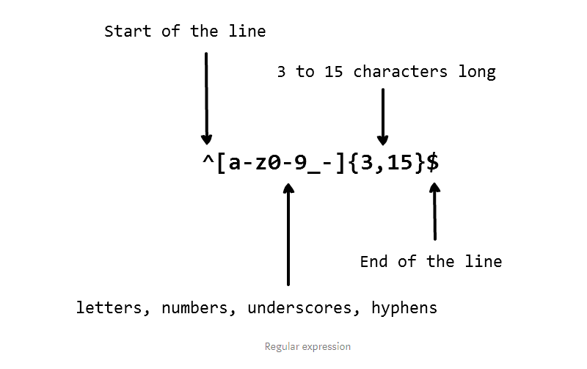
Regular Expression Modifiers: Option flags
Whether folloiwng strings will be accepted?
john_doe
jo-hn_doe
john12_as
Jo

Slide 37
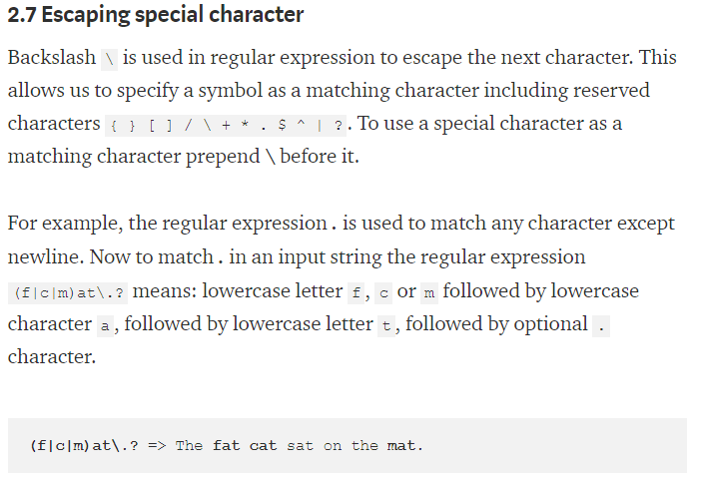
Regular Expression Modifiers: Option flags

Slide 38
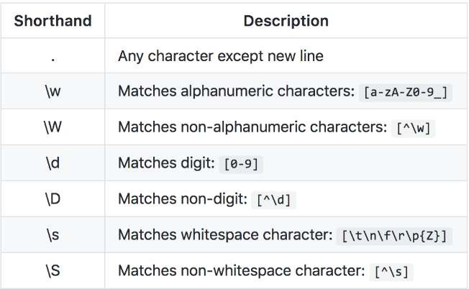
Regular Expression Modifiers: Option flags

Slide 39
findall() method
Searches all patterns and returns a list import re
a = “hello 234789 world 6378 ok 1 1115 alpha” print(re.findall(“\d+”, a))
{‘234789’ ‘6378’ ‘1’ ‘1115’}
\d – any numeric character
+ represents one or more previous character

Slide 40
compile() method
import re
file = open(“abc.txt”, “r”) text = file.readlines()
#compiling the regular expression keyword=re.compile(r’a ‘)
#search content line by line for line in text:
if keyword.search (line):
print(line)
Compiles a regular expression pattern into regular expression object which can be used match() and search() method
Syntax
re.compile (pattern, flags=0)
Output:
# only line contains a is displayed
Ram is a boy Geeta is a girl

